Slide 1
Advanced AB testing in practice
By: Eltsefon Mark

Slide 2
Bucketization. Why do we need another approach?
Growing data
Does bootstrapping help us while scaling ?

Slide 3

Bucketization. Intuition
Hash(UID) % B
1
2
B

Slide 4
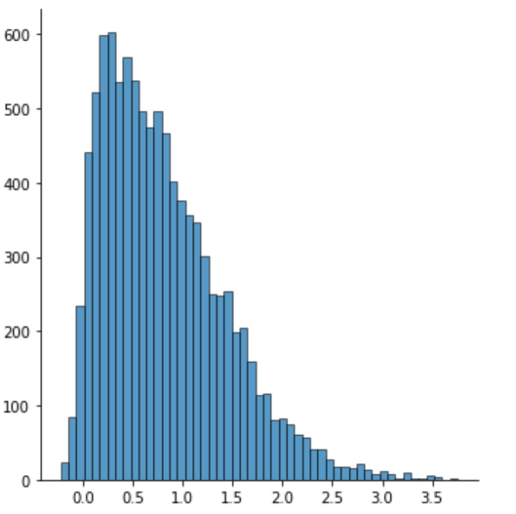
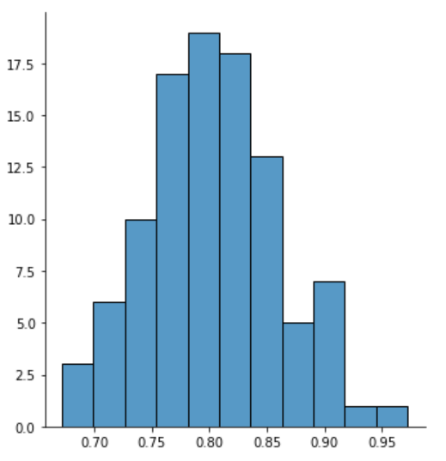
Bucketization. Advantages
1000
100

